Slide 1

The Scrum-Agile Approach
Andrew Rapolevich
CS-250
08/14/2022

Slide 2

What is Agile?
“The Agile methodology is a way to manage a project by breaking it up into several phases. It involves constant collaboration with stakeholders and continuous improvement at every stage. Once the work begins, teams' cycle through a process of planning, executing, and evaluating. Continuous collaboration is vital, both with team members and project stakeholders” (PROJECT MANAGEMENT GUIDE, 2022, para, 1).

Slide 3
Agile Team Roles
Product Owner:
The Product Owners’ responsibility is to maximize the value of the product created and to best utilize the development team.
Scrum Master:
The Scrum Master has the responsibility to host the scrum meeting and organize the development team during that time. The Scrum master also deals with product backlog.
Development Team:
The Development team creates the project that the Product Owner has in mind. They create the product and tailor it to the desires of the product owner. The team consists of multiple sub-roles like developers, testers, and analysts.

Slide 4
SDLC Phases
Planning
The team plans how the project will be completed and make predictions on requirements.
Analysis
The team receives input from the customer for what the requirements are, and the requirements are documented.
Design
Various design architects and approaches are considered between the stakeholders and the team.
Coding
Development of the product begins here and based on the product the coding language is decided.
Unit Testing
Any issues are brought to light with inhouse testing and debugged before product release.
The product is sent out as a prototype and if the product fulfills its objective can be released or re-assessed. The program is maintained, and small tweaks or adjustments are made.
Acceptance Testing

Slide 5
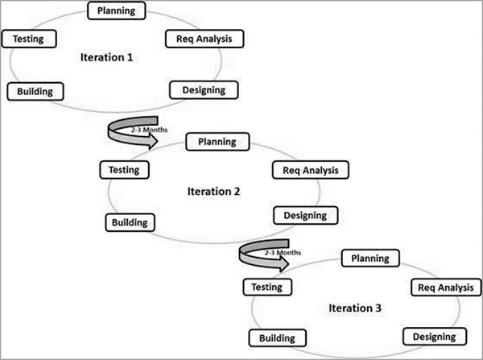
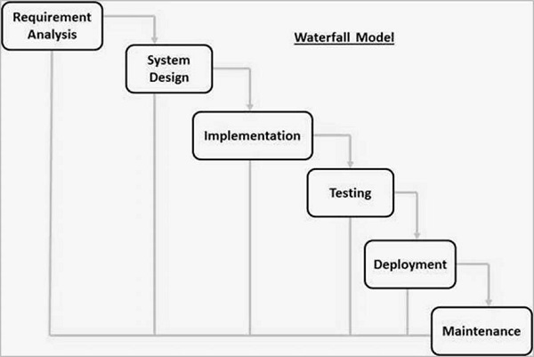
Agile
Agile or Waterfall?
Waterfall
SDLC - Quick Guide (tutorialspoint.com)

Slide 6
Agile
Agile or Waterfall?(Cont.)
Waterfall
Agile Method: The Agile method “is a combination of iterative and incremental process models with focus on process adaptability and customer satisfaction by rapid delivery of working software product.”(SDLC, 2022) This approach focuses on changes and a very dynamic view on the software development cycle. Agile works on the premise that every project requires different requirements and being adaptable is advantageous when planning these projects.
Waterfall Method: “The Waterfall Model was the first Process Model to be introduced. It is also referred to as a linear-sequential life cycle model. It is very simple to understand and use. In a waterfall model, each phase must be completed before the next phase can begin and there is no overlapping in the phases.” (SDLC,2022) This approach is a more rigid structured form of software development where changes are harder to impose because of its strict structure. Planning is important with the waterfall method and sets limitations on the project by having no wiggle room.
Assessment: When utilizing the agile method for the SNHU Travel project it felt like it was required to be more dynamic because of the desires of the shareholders/customers so I believe the agile method was the best fit. If we had utilized the waterfall method, we would have had a product that would not had resembled the result the users would’ve desired even though it would’ve been smoother for the development team.

Slide 7
Agile or Waterfall?(Factors to consider)
Waterfall Method:
Optimal choice when a project guidelines need to be strict and well enforced.
The waterfall approach is ideal for projects that have specific documentation, fixed requirements, ample resources, an established timeline and well-understood technology. (Lewis, 2019)
Not ideal for complex, high risk, ongoing or object-oriented projects. (Lewis, 2019)
Agile Method:
Optimal choice when a project guidelines need to be mutable and can change at any point.
Agile encourages a high degree of input and collaboration between the client and development team. (Agile Methodology, 2022)
Agile product development integrates regular testing into the development process. This makes it easier for the product owner to identify any issues early on and make changes as needed. (Agile Methodology, 2022)

Slide 8
Works Cited
Agile methodology: What it is, how it works, and why it matters. Lucidspark. (n.d.). Retrieved August 14, 2022, from https://lucidspark.com/blog/what-is-agile-methodology
Lewis, Sarah. “What Is Waterfall Model? - Definition from Whatis.com.” SearchSoftwareQuality, TechTarget, 7 Feb. 2019, https://www.techtarget.com/searchsoftwarequality/definition/waterfall-model.
SDLC - Overview. SDLC - Quick Guide. (n.d.). Retrieved August 14, 2022, from http://www.tutorialspoint.com/sdlc/sdlc_quick_guide.htm
What is Agile Methodology in project management? Wrike. (n.d.). Retrieved August 14, 2022, from https://www.wrike.com/project-management-guide/faq/what-is-agile-methodology-in-project-management/

